Slide 1
Educational Kit for Alkaline Membrane Fuel Cell (AMFC)
Team
------------------------------
Nicole Alvarez
Bryan Anderson
Collin Heiser
Mustafa Nek
James Richardson
Nicolas Schutz
Advisor: Juan Ordonez
Sponsor: FSU
Group 10

Slide 2
Why use an Alkaline Membrane?
Though expensive 80% of the used items during the process are reusable now
Alkaline Membrane Fuel Cells are the most electrically efficient fuel cell technology
Table 1. Fuel Cell Comparisons
Group 10 Bryan Anderson
Slide 2 of 13 Educational Kit of AMFC

Slide 3
Project Scope/ Overview
KOH Membrane
Anode/Cathode Sheets
Create and design an alkaline membrane fuel cell (AMFC tool kit for educational use)
Scaling
Bipolar Plates
“The current AMFC setup is too large and immobile to be a portable educational kit alkaline membrane fuel cell.”
Figure 1. Fuel Cell Exploded View
Group 10 Bryan Anderson Slide 3 of 13 Educational Kit of AMFC

Slide 4
Part List and Budget
Component | Cost | Notes
Pelican Case | $122.84 | need to use a cheaper alternative
Membrane Materials | $8.85 | Consumed during process
Tubing/waste water container | $2
Raw aluminum/machining cost | $72 | Price will drop dramatically after 1st parts
Compressed gases | $25 | Containers are reusable, gas will be consumed
Power output mechanism | $13 | Still in design process
Gas leak sensor | $40 | Battery operated sensor
Total | $284 | Too high
Group 10 Bryan Anderson
Slide 4 of 12 Educational Kit of AMFC

Slide 5
Marketing Plan
Due to the high cost per unit, individual sale is not profitable
Thus we will market these kits as FSU owned & maintained rentable educational tools
Who will rent these kits?
Advanced high school science programs
Community Colleges
Colleges and Universities
Group 10 Bryan Anderson
Slide 5 of 13 Educational Kit of AMFC

Slide 6
Challenges & Risks With Possible Solutions
Power output
Optimize system or power an object that requires less energy input
Transportation and storage of combustible gases
Oxygen filter attachment/ supply only containers for H₂
Excessive heat generation of fuel cell in operation
Preliminary test (10 min duration) displays no risk of harmful levels of heat generation
Corrosion of fuel cell due to liquid potassium hydroxide electrolyte
Group 10 James Richardson
Slide 6 of 13 Educational Kit of AMFC

Slide 7
Preliminary Testing
Mathematical modeling
Controlled Parameters:
Aspect ratios of width/length, height/length
Flow rates and molecular concentrations of the working fluids (H2 and O2) were designated
Varied Parameters:
The concentration of the liquid electrolyte (KOH) was varied – from 10% to 50%
The duration of time that the AMFC was operated also varied
Figure 2. Theoretical polarization curves for varying potassium hydroxide concentrations of an AMFC prototype (10% - 50%)
y (% KOH) | i (A) | V (V) | W/t (W)
10 | 0.00 | 0.92 | 0.00
 | 2.56 | 0.54 | 1.39
20 | 0.00 | 0.94 | 0.00
 | 3.28 | 0.62 | 2.05
30 | 0.00 | 0.98 | 0.00
 | 3.48 | 0.73 | 2.55
40 | 0.00 | 0.93 | 0.00
 | 4.11 | 0.72 | 2.98
50 | 0.00 | 0.98 | 0.00
 | 3.63 | 0.63 | 2.29
Table 3. Theoretical values for open and short circuit simulations at varying electrolyte concentrations
Group 10 James Richardson Slide 7 of 13 Educational Kit of AMFC

Slide 8
Preliminary Testing
Experimental Validation
Physical testing:
Apparatus assembled and tested with an approximate KOH concentration of 40%
Testing was carried out at UFPR
Testing lasted 10 minutes, results were only taken at the end of the 10 minute operation period
Figure 4. Experimental setup of Alkaline Membrane Fuel Cell prototype
W/t (W) | Theoretical | Experimental
y (% KOH) | 40 | ~40
i (A) | 4.11 | 6.68
V (V) | 0.93 | 0.82
Table 3. Comparison of the theoretical data obtain from the FORTRAN program compared to the results gathered from physical testing of the prototype
Group 10 James Richardson Slide 8 of 13 Educational Kit of AMFC

Slide 9
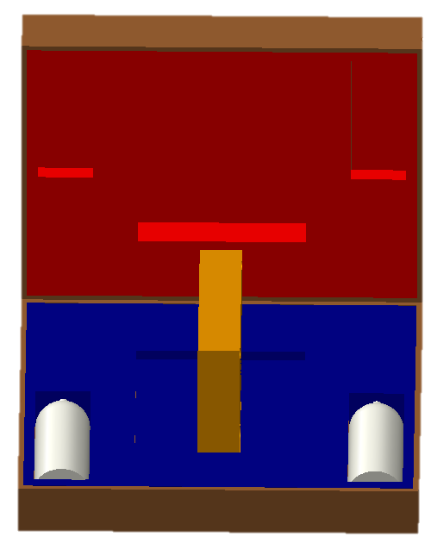
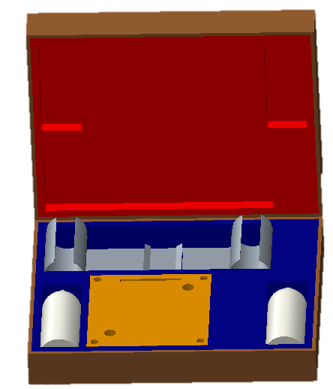
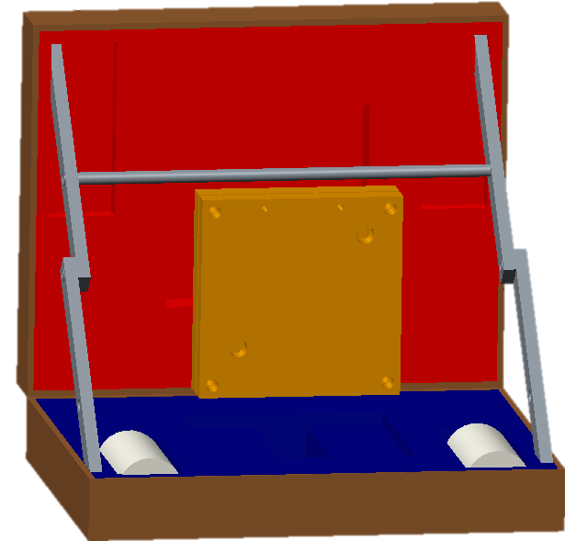
Design Choices
Design 1
Design 2
Design 3
Group 10 Collin Heiser
Slide 9 of 13 Educational Kit of AMFC

Slide 10
Overview of third Design
Everything is contained in case
Easy to manufacture and cheap support alternative
Support crossbeam collapses for easy storage
No risk of fuel cell falling over during operation
Group 10 Collin Heiser
Slide 10 of 13 Educational Kit of AMFC

Slide 11
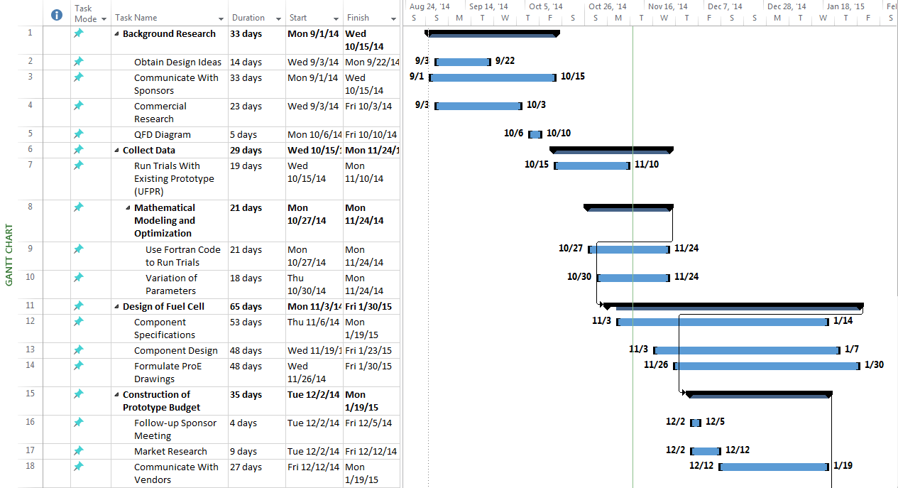
Project Plans
http://eng.fsu.edu/me/senior_design/2015/team10/
Group 10 Collin Heiser
Slide 11 of 13 Educational Kit of AMFC

Slide 12
References
Vargas, J.V C., and J. C. Ordonez. "Alkaline Membrane Fuel Cell (AMFC) Modeling and Experimental Validation." Journal of Power Sources (2012): 1-15.Www.elsevier.com/locate/jpowsour. Elsevier, 11 Apr. 2012. Web. 15 Sept. 2014.
Ordonez, Juan, and Jose Vargas. Design and Development of an Alkaline Membrane Fuel Cell (AMFC) Educational Kit for High School and College Level Laboratory Demonstration. Tallahassee: Florida State Univeristy, n.d. PDF.
Group 10
Slide 12 of 13 Educational Kit of AMFC

Slide 13
Questions
Group 10
Slide 13 of 13 Educational Kit of AMFC

